Slide 1


Capstone Project : P7
Team Coders

Slide 2




Members
3
4
Aarya Shah
(Leader)
Dhruvil Patel
Kavy Sanghani
Siddharthsinh
Vala

Slide 3
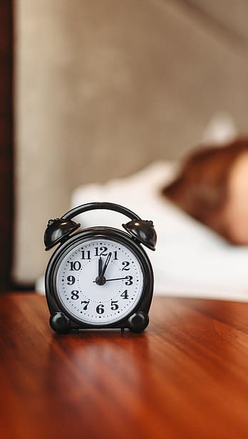
Problem
You are to build a Sleep Inducer. There are N inmates in total. Each has
his/her own sleep time (randomly initialized). The Sleep Inducer is installed in
a hostel with M sleeping dorms. It notes every inmate’s daily sleeping habits
and starts sleep-inducing music at bedtime. It works for multiple inmates.
However, the music should not continue beyond p minutes after going to bed
(assuming it takes that much time for every inmate to fall off to sleep). The
Sleep Inducer should be able to play for all of them without disturbing anyone
(i.e., playing music while someone is asleep). Therefore, it has to assign the
correct number of inmates for each dorm before starting to operate.

Slide 4
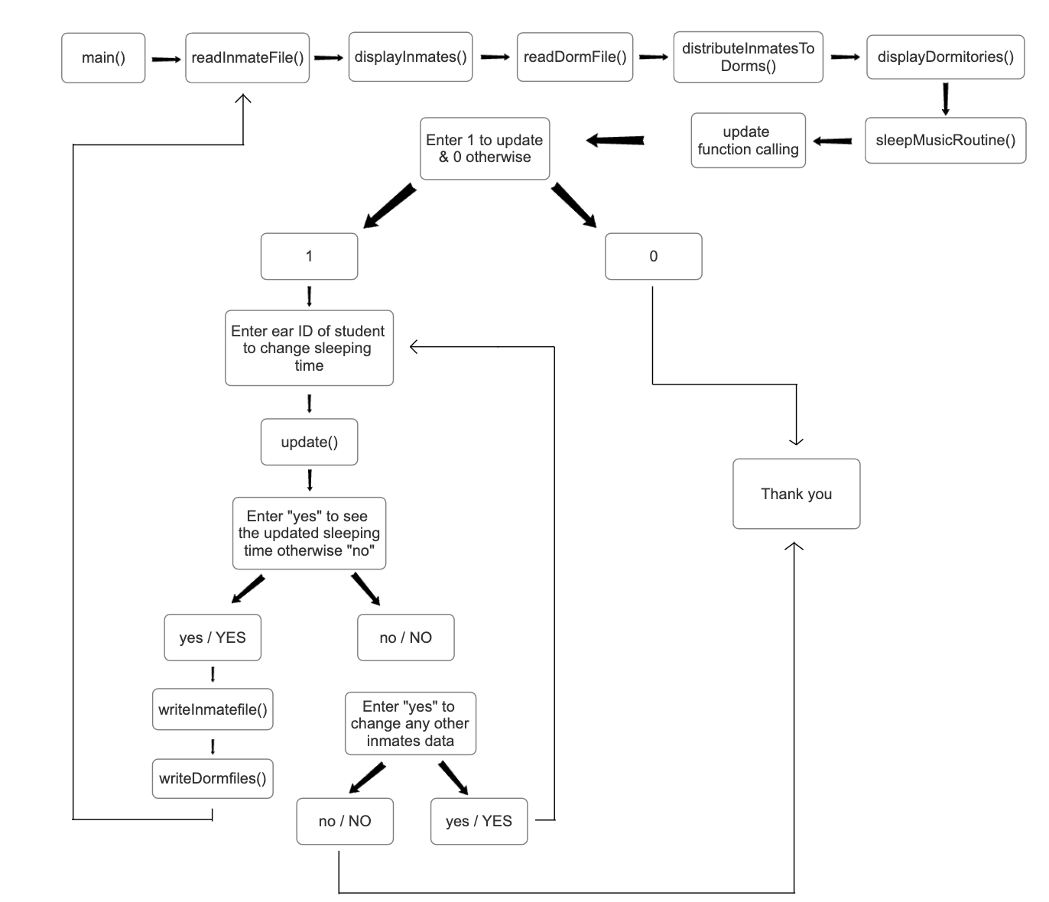
Algorithm

Slide 5
ReadInmateData
 | Name | Earpod ID | Monday | Tuesday | Wednesday | Thursday | Friday | Saturday | Sunday | Sleep Time
1 | Siddharth | 12345 | 10:00 PM | 11:00 PM | 1:00 AM | 10.30 PM | 3:00 AM | 8:50 PM | 9:00 PM | 30
2 | Kavy | 54321 | 3:00 AM | 10:15 PM | 9:00 PM | 2:30 AM | 11:30 PM | 11:00 PM | 11:45 PM | 15
3 | Dhruvil | 98765 | 11:15 PM | 12:45 AM | 10:30 PM | 11:00 PM | 10:45 PM | 11:30 PM | 11:15 PM | 12
4 | Aarya | 72345 | 11:00 PM | 10:30 PM | 10:45 PM | 11:15 PM | 10:00 PM | 11:30 PM | 11:45 PM | 20

Slide 6
ReadDormData
 | Dorm Name | No. Of Channels | Musics Per Channel
1 | Dorm_x | 2 | 2
2 | Dorm_y | 2 | 3
3 | Dorm_z | 2 | 10

Slide 7




DistributeInmatesToDorms
Takuma Hayashi
Aarya
Siddharth
Dhruvil
Kavy
Mirjam Nilsson
Dorm_x
Dorm_y
Dorm_z
President
Rajesh Santoshi
Flora Berggren

Slide 8
DistributeInmatesToDorms
Mirjam Nilsson
Siddharth
Aarya
Dhruvil
Kavy
Dorm_x
Dorm_y
Dorm_z
President
Rajesh Santoshi
Flora Berggren

Slide 9
Data Structure Chosen
Unordered Map (Hash Table):Fast Access: The unordered_map<string, Dorm_detail> is used to store dorm details with dorm names as keys. Hash tables offer fast access to elements based on their keys. In this case, dormitory details can be retrieved quickly using the dorm names.Efficient Lookup: With hash tables, the time complexity for key-based lookup, insertion, and deletion operations is typically 𝑂(1)O(1) on average. This makes unordered maps suitable for scenarios where fast access to data based on unique keys is required, as seen in this code for accessing dorm details.

Slide 10
Data Structure Chosen
Vectors:Dynamic Resizing: Vectors are used to store dynamic lists of data, such as inmate details, daily sleep records, music channels per dorm, and inmates assigned to dorms. Vectors provide dynamic resizing, meaning they can automatically resize themselves to accommodate more elements as needed.Efficient Iteration: Vectors offer efficient iteration over elements using iterators or indices. This makes it easy to traverse and manipulate sequences of data, such as iterating over all inmates or their daily sleep records.Random Access: Vectors support random access, allowing direct access to elements based on their indices. This enables efficient lookup and modification of specific elements, which is useful when updating an inmate's sleep schedule or accessing elements at specific positions.Contiguous Memory Allocation: Vectors store elements in contiguous memory locations, which provides cache locality and enhances performance, especially for iterative operations or when accessing consecutive elements.

Slide 11
Time Complexity
ReadInmateFile
It involves iterating the lines through the file and if there are ’n’ number
of lines in the file then its time complexity will be O(n)
readDormFile
Similar to inmate file if we have ’n’ number of lines then time complexity
will be O(n)

Slide 12
Time Complexity
writeInmateFile
It involves writing into the file thus appending data into the file now if
here we add ’n’ number of lines then the time complexity will be O(n)
writeDormFile
This approach is also same as above hence if there is ’n’ lines to append
then time complexity will be O(n)

Slide 13
Time Complexity
displayInmates
Here there is 1 for loop which iterates over the number on inmates and there is another nested loop in it that is loop 2 which iterates over the daily sleeping time hence if we consider that there are ’n’ number of inmates and there are ’k’ sleeping times then time complexity will be O(n*k) but in our example, we have fixed the days as 7 ie we cannot exceed more than 7 so time complexity is O(n)
displayDormitories
Similar to inmate file if we have ’n’ number of lines then time complexity
will be O(n)

Slide 14
Time Complexity
distributeInmatesToDorms
Here we have considered hash map so average time complexity of inserting data will be O(1) but now if we consider ’n’ as the number of inmates and ’m’ as the number of dorms then the time complexity will be O(n*m)
For fetching a particular dorm it will be O(1)
Assume there are ’n’ number of dorms so if we traverse each then it will give time complexity as O(n)
w_day is fixed for 7 days in the while loop so it will give constant time:- O(1)
Consider there are ’m’ inmates, now on sorting ’m’ inmates through sort() function it give time complexity as O(mlogm).
Now again on calling the music channels for ’m’ inmates we have O(m)
Thus for this function time complexity is O(n*(mlogm+m)).
sleepMusicRoutine

Slide 15
Time Complexity
music_playing
It involves extraction of data into hour minute colon and am_pm this is done in constant time O(1)
Also it calculates the sleeping end time in constant time O(1)
It prints in O(1)
Thus overall time complexity is O(1)
Update Function
Here also let there are ’n’ inmates if it iterates over ’n’ items then its time complexity is O(n)
Another loop will be for a constant 7 days so if it is of ’k’ days then its time complexity is O(k)

Slide 16
Final Time Complexity
Hence the total time complexity is O(n+k)
Hence the total time complexity is O(n+k)
Hence the total time complexity is O(n+k)
Because of Extra vectors and Unordered map

Slide 17
More Functions:-​
music_playing()
sleepMusicRoutine()
Update()
​

Slide 18
music_playing()
1] Print the activation message for music channels, including the inmate name, earphone Id
and sleeping time for that inmate.
2] Parse the sleeping time string to extract hour, minutes, colon(:), and the am/pm indicator.
3] Firstly check if the time is in PM, if it is PM and not 12 then add 12 to the hour of that
inmate.
4] Now calculate the deactivating hours(end_hours) and minutes of the inmate and check if
deactivating(end_hour) is greater then 12. If yes then subtract 24 from it.
5] Now check if the start time and end time is in midnight crossovers. Convert the end_hour
back into the 12 hour format and from that determine the AM/PM of the string.
6] Now print the deactivating message which contains the ear_id name and the sleeping
time.
7] Also we have set width and fill functions in order to get the last string character.

Slide 19
sleepMusicRoutine()
The process involves iterating through an unordered map of dormitory data, which contains dorm names as keys and `Dorm_detail` objects as values. For each dorm, if it's empty, print a message. Otherwise, collect inmates into a vector (`sortedInmates`) and sort them using a lambda function based on their sleeping times for a specific day (`w_day`). The lambda function converts sleeping times to 24-hour format, handling AM/PM properly, and compares the times for sorting. It prioritizes PM over AM times, ensuring that inmates sleeping in the PM are given precedence over those sleeping in the AM.

Slide 20

Update()
1] Assign a Boolean variable as validEarId to false.
2] Form a iterator named as inmate which iterated over the inmateList vector.
- Now check if the ear ID of the current inmate matches the given "earId".
- If it matches then set validEarId to true.
13
- Using while loop ask user to enter the day of change, the new sleep time for that day.
- Print “New sleep time updated successfully”.
- Then again ask user if he wants to change the data of another day, if yes then repeat the
above detail otherwise break the loop.
- Ask to see the changed time.
- For invalid ear ID print “Please enter a valid ear id.”.

Slide 21
Link For Video Explanation
Link For Report

Slide 22
Thank you

